Slide 1


Idaho’s Ecosystem
of Transparency
December 17, 2025
Presented by:
State Controller Brandon D Woolf

Slide 2
Today’s Conversation
Why Transparency Matters
Townhall Idaho: State Public Meeting
Transparent Idaho: Understanding Public Data
What’s Next and Your Questions

Slide 3








Not Just Websites
Idaho’s Transparency Ecosystem
Public
Records
State Agreements
& Contracts

Slide 4

Why Transparency
Restore Public Trust
Instigates a Cultural Change of Transparency
Deters Fraud
Increase Accountability
Provides Validity for Data Driven Decisions

Slide 5
Why Transparency
Transparency Works when Information is…
Accessible
Understandable
Usable

Slide 6

Look Ahead
Transparency
AI tools for Data Analysis
Refining Education Data with Comparisons
Financial Health of an Entity

Slide 7
Look Ahead
Transparency
AI tools for Data Analysis
Refining Education Data with Comparisons
Financial Health of an Entity

Slide 8
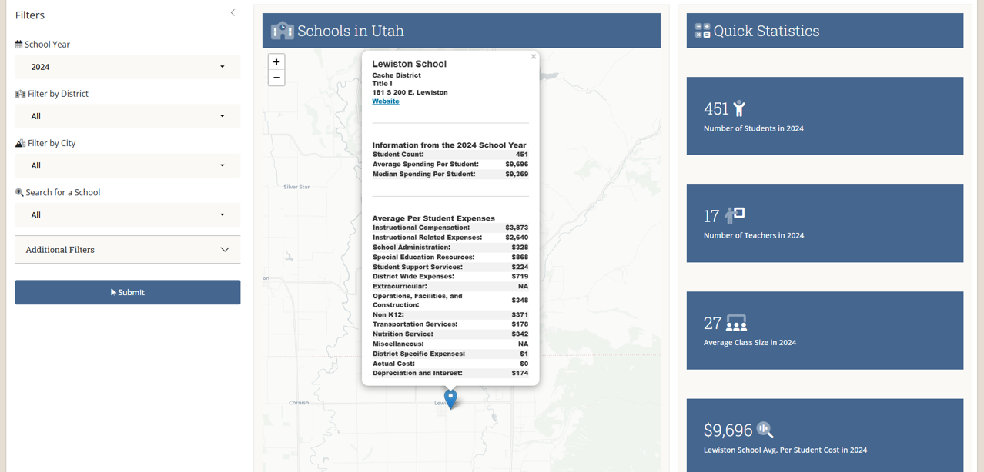


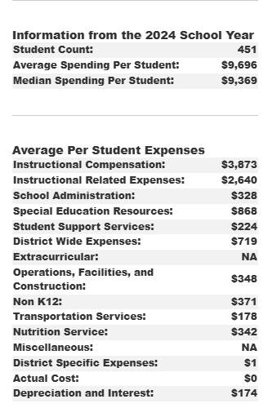


Schools in Idaho
School Name
Look Ahead
Refining Education Data with Comparisons

Slide 9
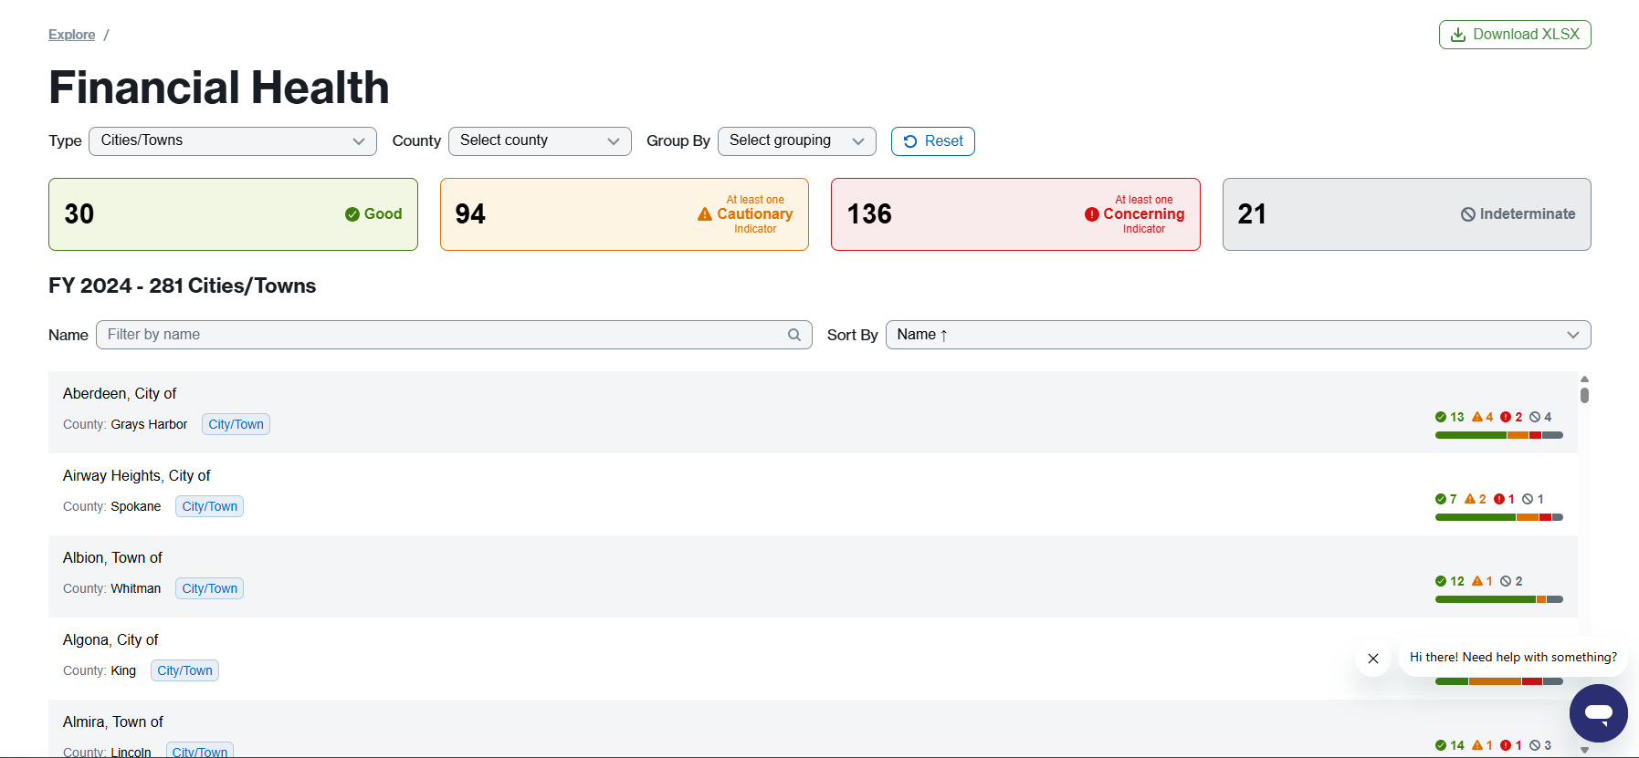
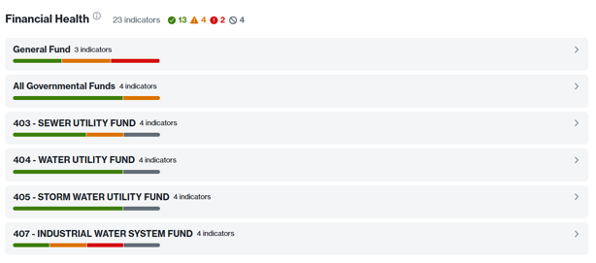

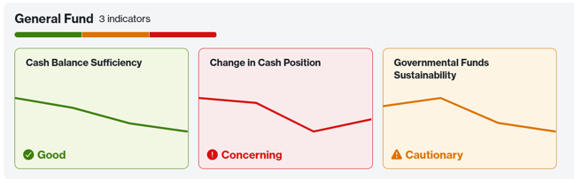
City Name
City Name
City Name
City Name
City Name
Look Ahead
Financial Health of an Entity

Slide 10





Q&A
What would you like to see on Transparent Idaho?
Resources
Email: transparentidaho@sco.idaho.gov
Web: https://transparent.idaho.gov
Phone: (208) 334-3100
Videos: https://www.youtube.com/@TransparentIdaho

