Slide 1
CAMPAIGN FINANCE & LOBBYING
The rules and how to access data

Slide 2
CAMPAIGN FINANCE Reporting Basics
All money raised or spent in relation to a campaign must be accounted for and tracked. This includes the use of the candidate’s personal money.

Slide 3
Where to Report
Secretary Of State Campaign Finance Portal
sunshine.voteidaho.gov
State Officials
The Secretary of State provides assistance, oversight and enforcement for state, legislative & judicial officials
Local Officials
The County Clerk provides assistance, oversight and enforcement for cities, schools and local districts

Slide 4
REMEMBER....
No one was ever fined for over-reporting

Slide 5
Contribution Limits
$1,000 maximum contribution per individual, business, or political committee, per election
Any single contribution of $1,000 or more must be reported within 48 hours of receipt
Notes:
- $1,000 per contributor per election: individual, business, or political committee
- Contributions of $1,000 or more must be reported within 48 hours of receipt
- Businesses with shared ownership are limited to $1,000 combined

Slide 6


Contribution Limits
Businesses sharing controlling ownership limited to $1,000 combined contributions
Contribution Limits​
Individual
Business Owned by
Individual
Business Owned by
Individual

Slide 7
Treasurer Appointment & Reporting
Once a statewide or legislative candidate has declared their candidacy or a local candidate has raised or spent $500:
Must file the appointment of a political treasurer
Begin reporting campaign finances
Include the sources and expenses for first $500 (in the case of local candidates)
Declaration of candidacy filed to run for office designates the candidate as the default political treasurer, for those who have not met the $500 threshold, until an alternative is appointed.

Slide 8


Filing Deadlines
10th of each month in the year of the election
Annual report due January 10th following non-election years
$50 fine each day after 48 hours late

Slide 9

Disclosures
All campaign materials should contain a disclosure statement, including communications that are broadcast or mailed, printed in newspapers or magazines, signs, and direct mailings.
The person responsible for the communication shall be clearly indicated.
Example: Paid for by Yosemite Sam for Governor

Slide 10
LOBBYIST Reporting Basics
Money spent to influence government officials and decisions must be tracked and reported.

Slide 11
Note: Lobbying Laws Have Changed
What has changed?
Monthly reporting for all lobbyists and state entities
The addition of “Indirect Lobbying”
The addition of a “paid for by” disclaimer requirement on public communications
Removal of an annual report (and semi-annual report for executive-only lobbyists and state entities)
As of July 1, 2025, lobbying laws are now found in
Chapter 7, Title 74, Idaho Code
Transparent and Ethical Government

Slide 12
Who Must Register as a Lobbyist
Anyone trying to influence the government's decisions privately must register as a lobbyist, as well as individuals associated with a business who make efforts to maintain relationships, entertain or promote goodwill with members of the legislature.
Exceptions:
News media
Members representing a religious group
Members of a trade association/business with a designated lobbyist
Those who are not compensated or who receive less than $250 a calendar quarter for lobbying

Slide 13
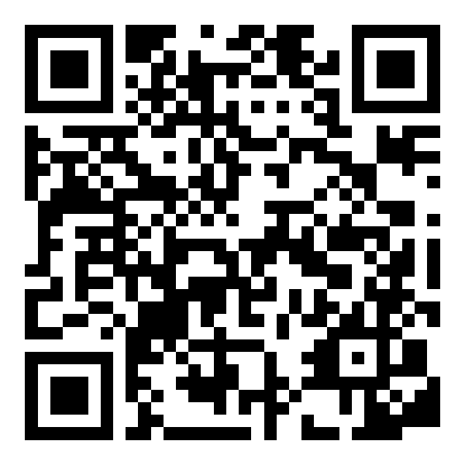
Registering
Secretary Of State Lobbyist Portal
sos.idaho.gov/elections-division/lobbyist-information/
Register annually
Register before lobbying, or within 30 days after being designated/employed as a lobbyist

Slide 14
Reporting Requirements
Report all money spent on entertainment, food and refreshment, honoraria, travel, lodging, and indirect lobbying activities, including billboards, mass texts, door-to-door campaigns, or digital ads.
There is no limitation on spending, but there is a requirement to itemize any expenditure over $135 per elected official.
Indirect lobbying expenditures of $100 or more must be reported within 48 hours.

Slide 15
Filing Deadlines and Fees
15th of each month for the previous month’s activities
Filing fee of $10 for each employer
$50 fine each day after 48 hours late

Slide 16
Thank you!

